Slide 1
Ch.34 Project Scheduling

Slide 2
Why Are Projects Late?
an unrealistic deadline established by someone outside the software development group
changing customer requirements that are not reflected in schedule changes;
an honest underestimate of the amount of effort and/or the number of resources that will be required to do the job;
predictable and/or unpredictable risks that were not considered when the project commenced;
technical difficulties that could not have been foreseen in advance;
human difficulties that could not have been foreseen in advance;
miscommunication among project staff that results in delays;
a failure by project management to recognize that the project is falling behind schedule and a lack of action to correct the problem

Slide 3
Scheduling Principles
compartmentalization—define distinct tasks
interdependency—indicate task interrelationship
effort validation—be sure resources are available
defined responsibilities—people must be assigned
defined outcomes—each task must have an output
defined milestones—review for quality

Slide 4
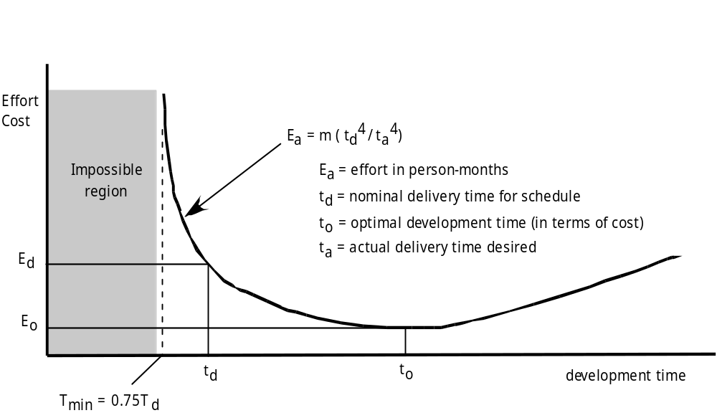
Effort and Delivery Time

Slide 5
Effort Allocation
“front end” activities
  customer communication
  analysis
  design
  review and modification
construction activities
  coding or code generation
testing and installation
  unit, integration
  white-box, black box
  regression
40-50%
15-20%
30-40%

Slide 6
Defining Task Sets
determine type of project
assess the degree of rigor required
identify adaptation criteria
select appropriate software engineering tasks

Slide 7
Task Set Refinement
1.1 Concept scoping determines the overall scope of the project.
Task definition: Task 1.1 Concept Scoping
1.1.1 Identify need, benefits and potential customers;
1.1.2 Define desired output/control and input events that drive the application;
Begin Task 1.1.2
1.1.2.1 FTR: Review written description of need
  FTR indicates that a formal technical review (Chapter 26) is to be conducted.
1.1.2.2 Derive a list of customer visible outputs/inputs
1.1.2.3 FTR: Review outputs/inputs with customer and revise as required;
endtask Task 1.1.2
1.1.3 Define the functionality/behavior for each major function;
Begin Task 1.1.3
1.1.3.1 FTR: Review output and input data objects derived in task 1.1.2;
1.1.3.2 Derive a model of functions/behaviors;
1.1.3.3 FTR: Review functions/behaviors with customer and revise as required;
endtask Task 1.1.3
1.1.4 Isolate those elements of the technology to be implemented in software;
1.1.5 Research availability of existing software;
1.1.6 Define technical feasibility;
1.1.7 Make quick estimate of size;
1.1.8 Create a Scope Definition;
endTask definition: Task 1.1
is refined to

Slide 8
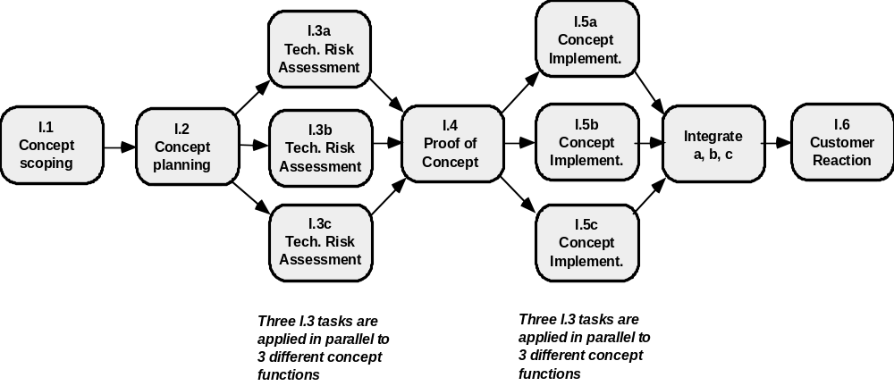
Define a Task Network

Slide 9
Timeline Charts
Tasks
Week 1
Week 2
Week 3
Week 4
Week n
Task 1
Task 2
Task 3
Task 4
Task 5
Task 6
Task 7
Task 8
Task 9
Task 10
Task 11
Task 12

Slide 10
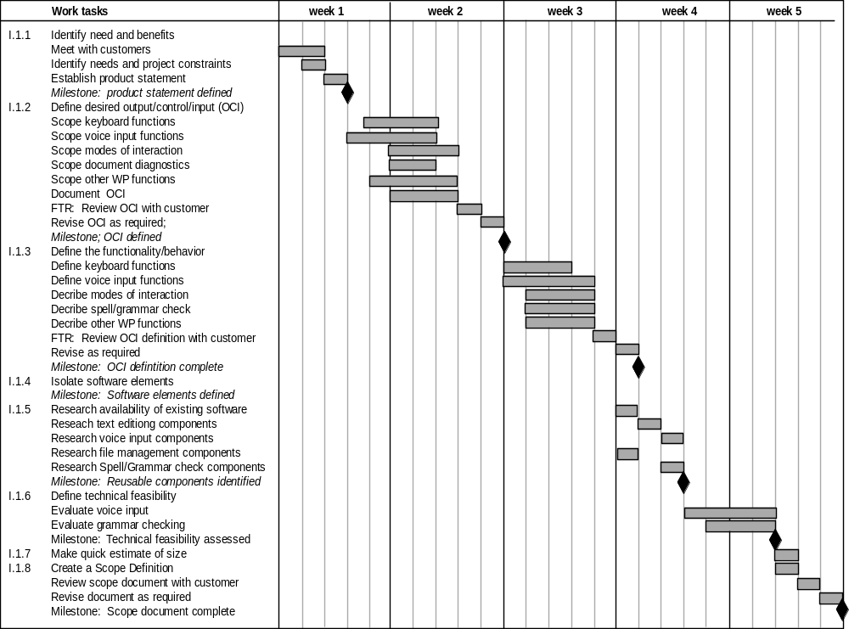
Use Automated Tools to Derive a Timeline Chart

Slide 11
Schedule Tracking
conduct periodic project status meetings in which each team member reports progress and problems.
evaluate the results of all reviews conducted throughout the software engineering process.
determine whether formal project milestones (the diamonds shown in Figure 34.3) have been accomplished by the scheduled date.
compare actual start-date to planned start-date for each project task listed in the resource table (Figure 34.4).
meet informally with practitioners to obtain their subjective assessment of progress to date and problems on the horizon.
use earned value analysis (Section 34.6) to assess progress quantitatively.

Slide 12
Progress on an OO Project-I
Technical milestone: OO analysis completed
  All classes and the class hierarchy have been defined and reviewed.
  Class attributes and operations associated with a class have been defined and reviewed.
  Class relationships (Chapter 10) have been established and reviewed.
  A behavioral model (Chapter 11) has been created and reviewed.
  Reusable classes have been noted.
  Technical milestone: OO design completed
  The set of subsystems (Chapter 12) has been defined and reviewed.
  Classes are allocated to subsystems and reviewed.
  Task allocation has been established and reviewed.
  Responsibilities and collaborations (Chapter 12) have been identified.
  Attributes and operations have been designed and reviewed.
  The communication model has been created and reviewed.

Slide 13
Progress on an OO Project-II
Technical milestone: OO programming completed
  Each new class has been implemented in code from the design model.
  Extracted classes (from a reuse library) have been implemented.
  Prototype or increment has been built.
  Technical milestone: OO testing
  The correctness and completeness of OO analysis and design models has been reviewed.
  A class-responsibility-collaboration network (Chapter 10) has been developed and reviewed.
  Test cases are designed and class-level tests (Chapter 24) have been conducted for each class.
  Test cases are designed and cluster testing (Chapter 24) is completed and the classes are integrated.
  System level tests have been completed.

Slide 14
Earned Value Analysis (EVA)
Earned value
  is a measure of progress
  enables us to assess the “percent of completeness” of a project using quantitative analysis rather than rely on a gut feeling
  “provides accurate and reliable readings of performance from as early as 15 percent into the project.” [Fle98]

Slide 15
Computing Earned Value-I
The budgeted cost of work scheduled (BCWS) is determined for each work task represented in the schedule.
  BCWSi is the effort planned for work task i.
  To determine progress at a given point along the project schedule, the value of BCWS is the sum of the BCWS_{i} values for all work tasks that should have been completed by that point in time on the project schedule.
The BCWS values for all work tasks are summed to derive the budget at completion, BAC. Hence,
  BAC = ∑ (BCWS_{k}) for all tasks k

Slide 16
Computing Earned Value-II
Next, the value for budgeted cost of work performed (BCWP) is computed.
  The value for BCWP is the sum of the BCWS values for all work tasks that have actually been completed by a point in time on the project schedule.
“the distinction between the BCWS and the BCWP is that the former represents the budget of the activities that were planned to be completed and the latter represents the budget of the activities that actually were completed.” [Wil99]
Given values for BCWS, BAC, and BCWP, important progress indicators can be computed:
  Schedule performance index, SPI = BCWP/BCWS
  Schedule variance, SV = BCWP – BCWS
  SPI is an indication of the efficiency with which the project is utilizing scheduled resources.

Slide 17
Computing Earned Value-III
Percent scheduled for completion = BCWS/BAC
  provides an indication of the percentage of work that should have been completed by time t.
Percent complete = BCWP/BAC
  provides a quantitative indication of the percent of completeness of the project at a given point in time, t.
  Actual cost of work performed, ACWP, is the sum of the effort actually expended on work tasks that have been completed by a point in time on the project schedule. It is then possible to compute
  Cost performance index, CPI = BCWP/ACWP
  Cost variance, CV = BCWP – ACWP

